Slide 1
Online Grocery Shoping
Yuvaajithan C

Slide 2
Technologies Used:
HTML
CSS
Java Script
Java
Hibernet
Software Used:
STS
Xampp server

Slide 3
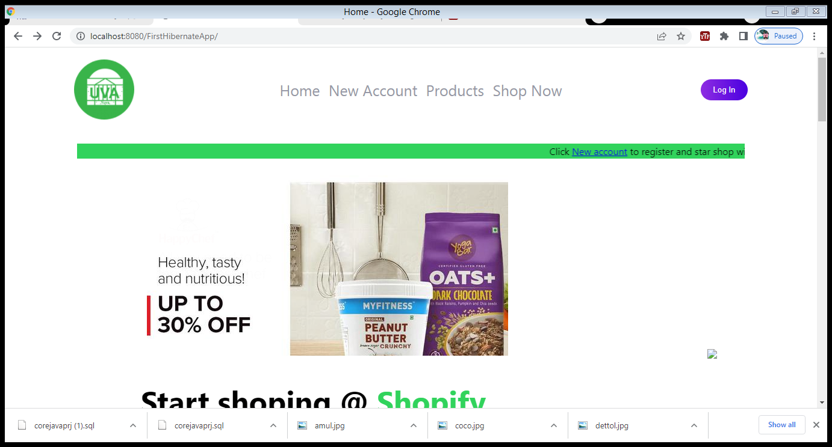
Page Content:
Home Page
User Login Page
Admin Panel

Slide 4
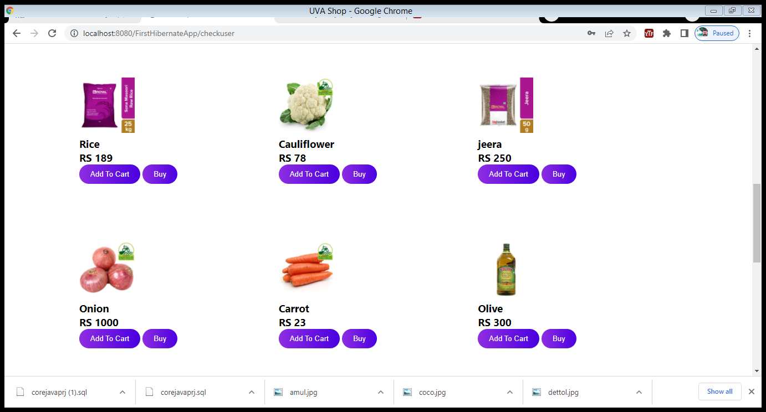
User Panel:
Here registered users can buy products and can add products to cart.

Slide 5
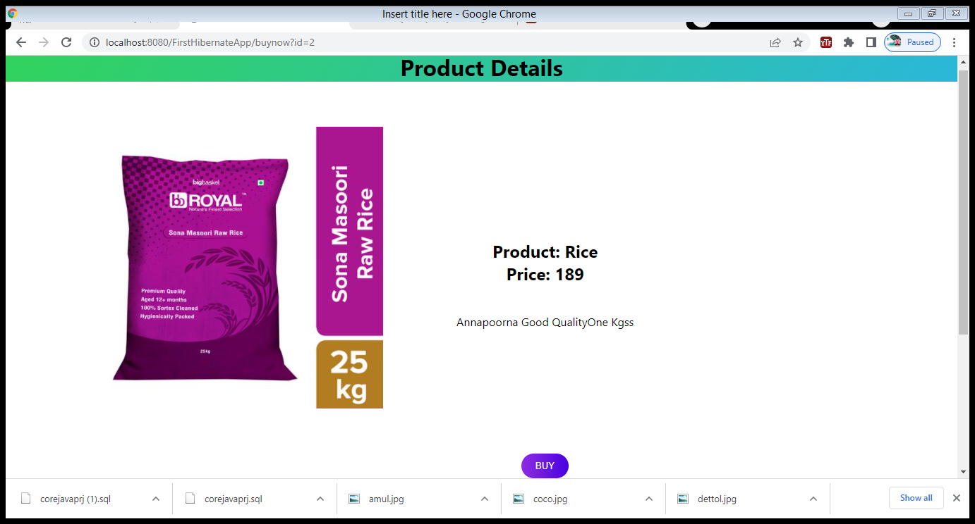
Product Details Page:
When user click on buy button it will show the product detail along with buy button
Using that buy button user can place order.

Slide 6
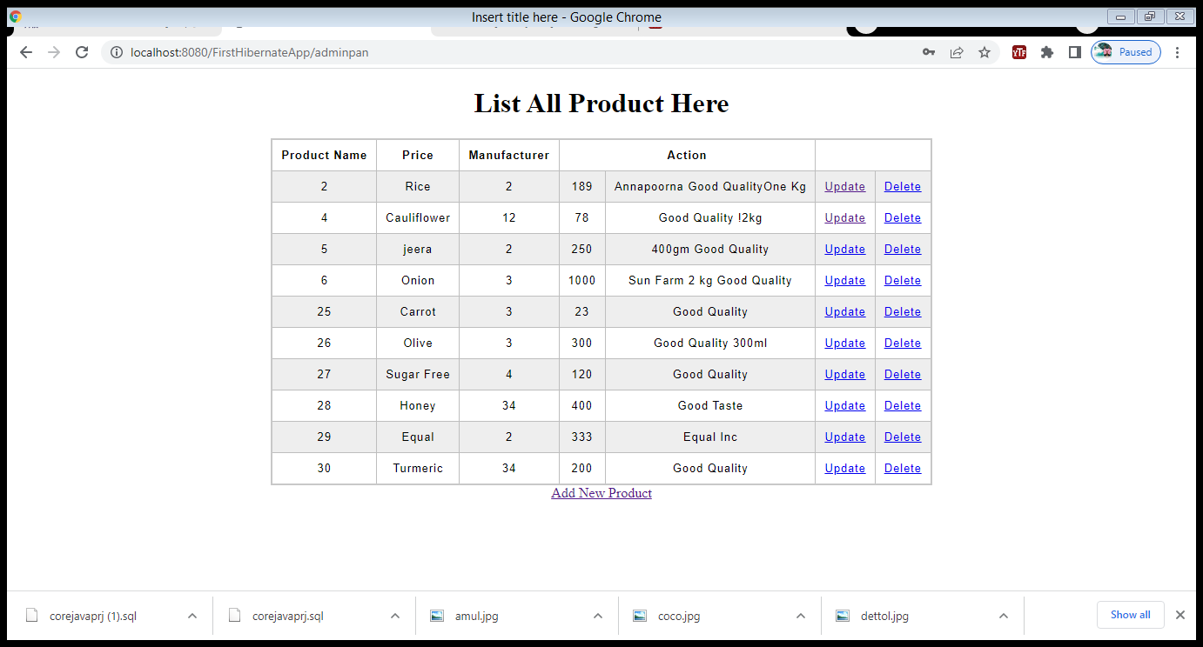
Admin panel:
When admin sign in, this page will show the all products list.
Admin can make changes on the product like delete , update can also add new product to sell.

Slide 7
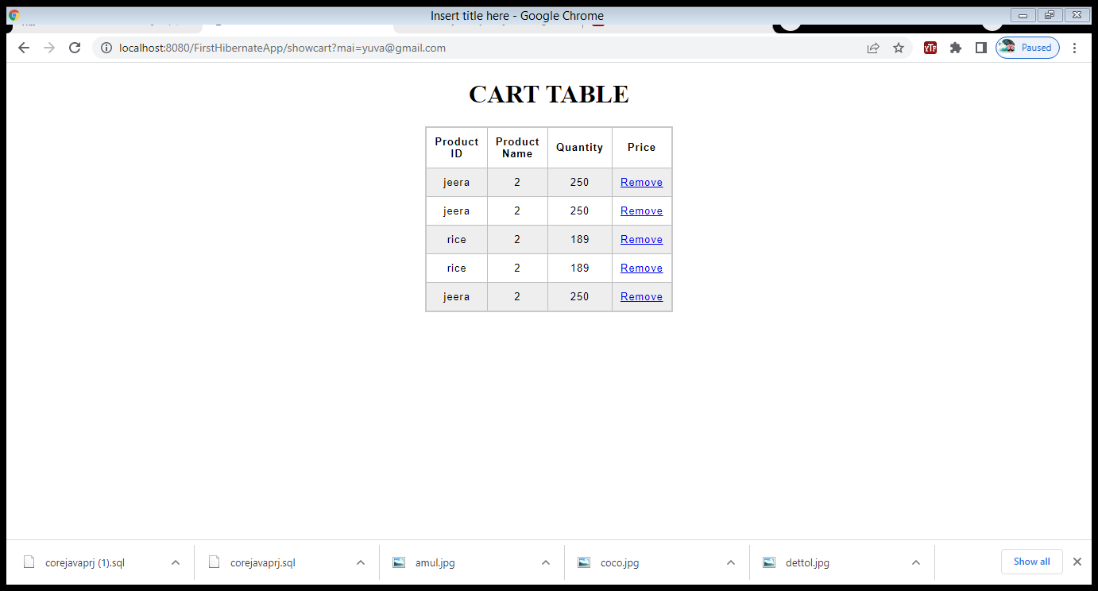
User Cart:
Users can add product to their cart by pressing the add to cart button.
It will add the product to cart table
This page will show list of products in cart added by the user when user press show cart button.
The cart products are unique for each singed in users.

Slide 8
Thanks
Yuva Ajithan C

